Slide 1
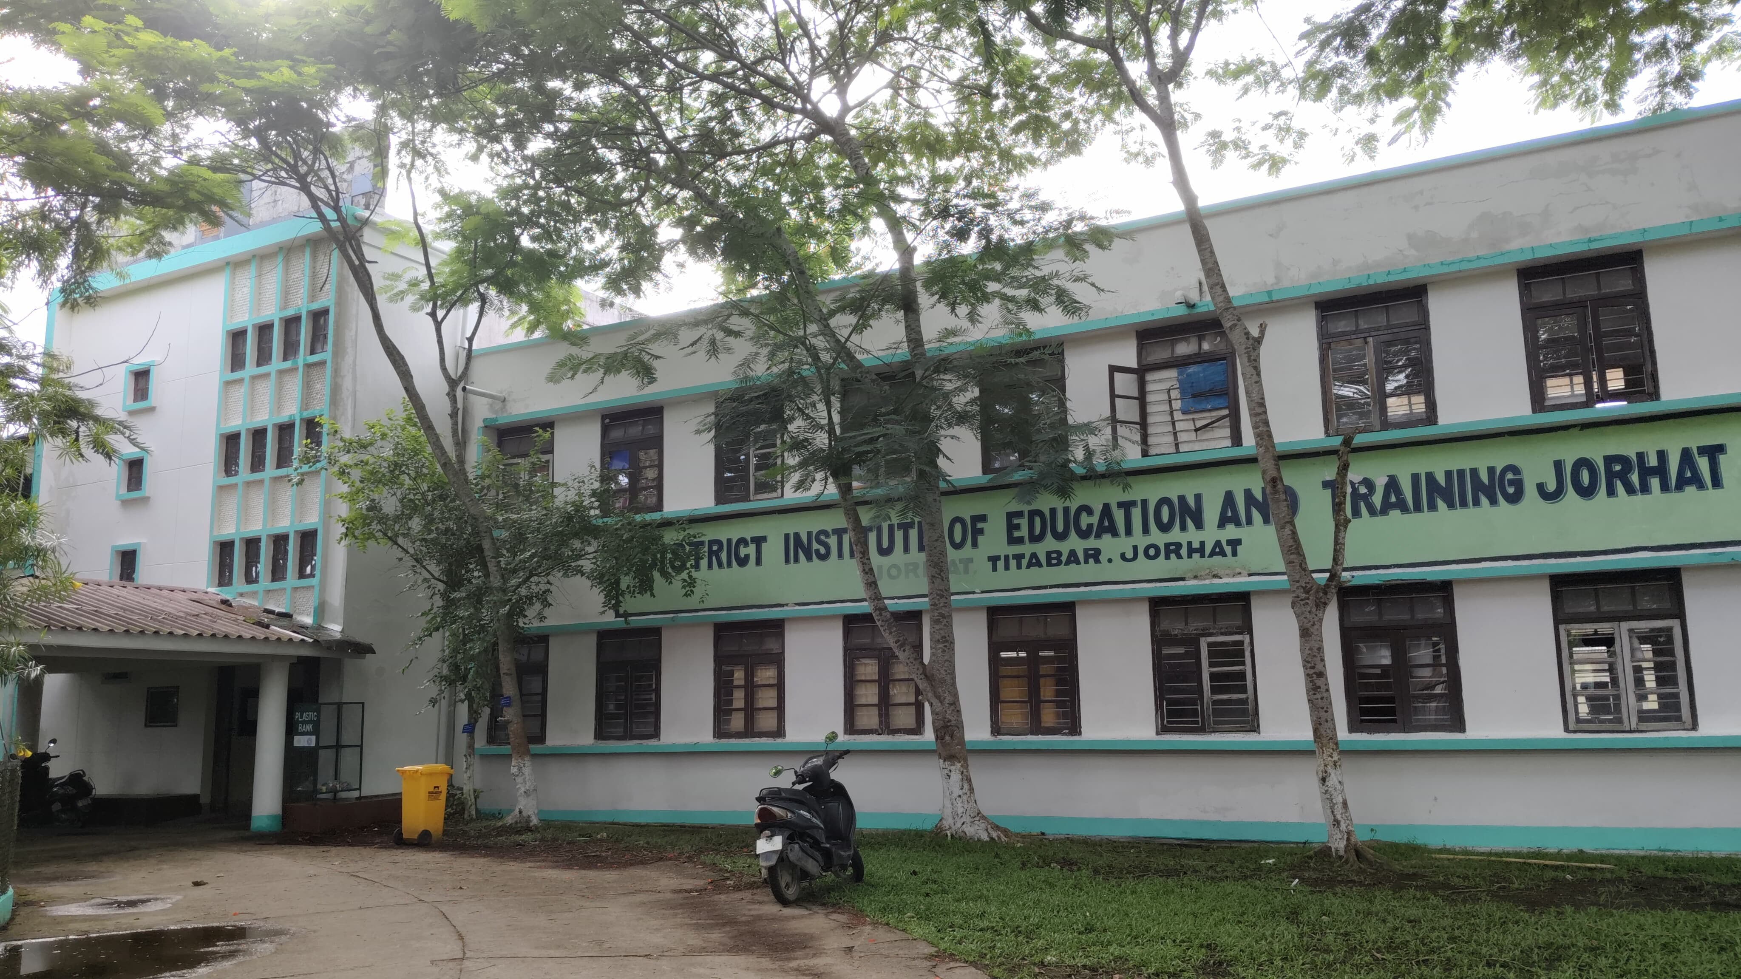

INITIATIVE BY
DIET JORHAT, TITABAR
CENTRE OF EXCELLENCE
Turning Waste into Wealth
Please log into www.dietjorhat.in
Email address: dietjorhat@rediffmail.com

Slide 2
OUR VISION
AS A CENTRE OF EXCELLENCE WE ENVISION TO ACT AS A CATALYST IN SHAPING A LEARNING ENVIRONMENT BY GROOMING LEARNING TEACHERS, PARTNERING WITH A LEARNING COMMUNITY AND CREATING A QUALITY EDUCATION SYSTEM THROUGH CONTINUOUS PROFESSIONAL DEVELOPMENT PROGRAMMES, INNOVATIVE AND TRANSFORMING PRACTICES

Slide 3
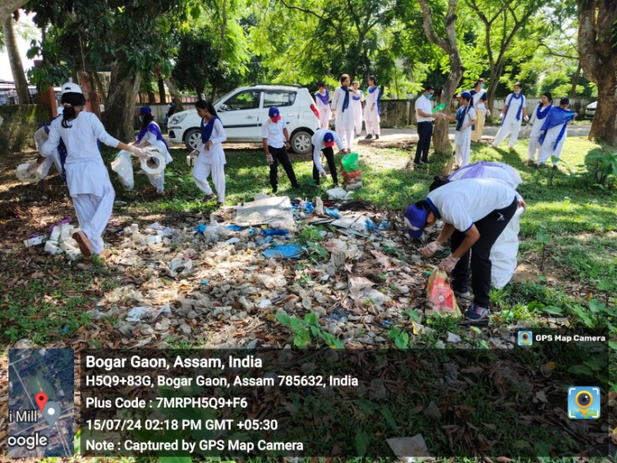
EMPOWERING STUDENT TEACHERS FOR SUSTAINABLE WASTE MANAGEMENT
Towards a Greener Campus

Slide 4
BACKGROUND
Assam Science Technology and Environment Council (ASTEC) conducted a Green Audit’ for DIET Jorhat. The audit involved biodiversity (Green Campus) as the target area . The report provided recommendation that can be used to develop an ‘Environmental Management Plan’ which is to be followed to minimize the impact on the institutional working framework.
Objectives of Green Campus:
To foster a long term environment
To ensure optimum environment for learning
To create a balanced ecosystem for everyone associated to the institution
.

Slide 5
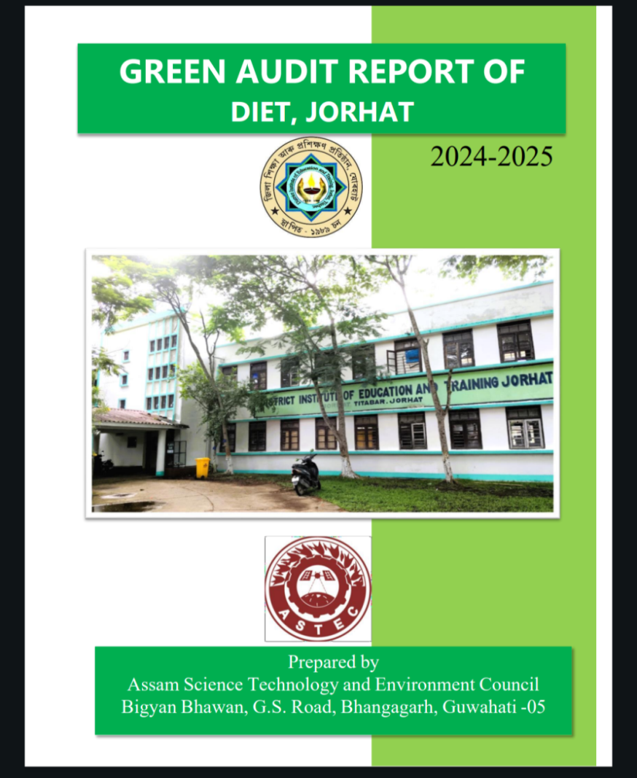
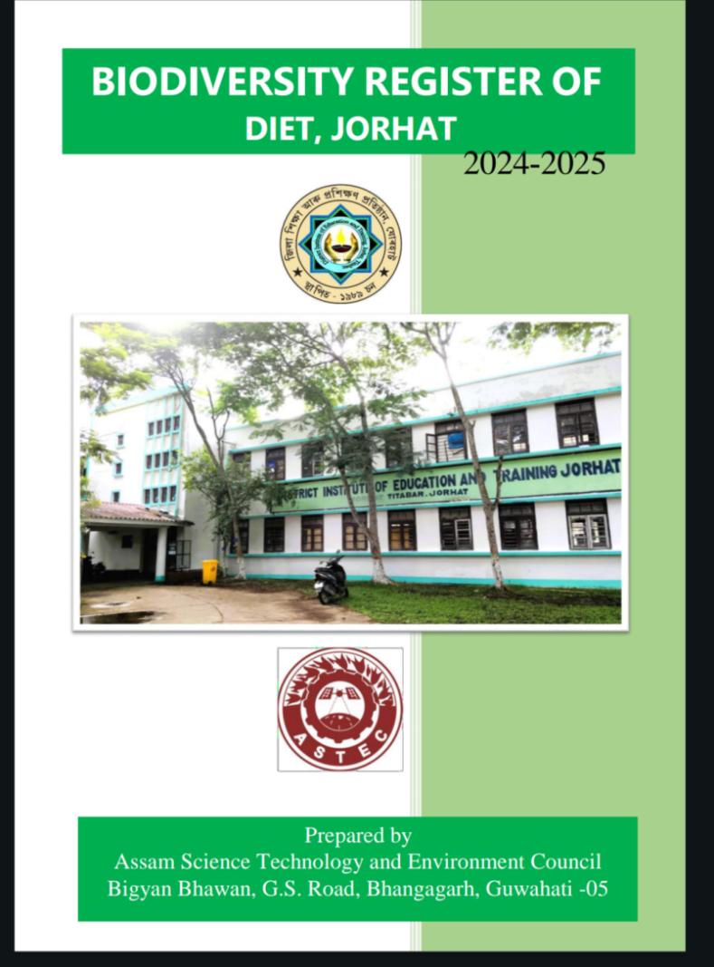
GREEN AUDIT AND BIODIVERSITY REGISTER BY ASTEC

Slide 6
TURNING WASTE INTO WEALTH :OUR INITIATIVE
Establishment of an Environmental Management System (EMS) comprising of faculty members , staff and student volunteers to ensure coordination of all green initiatives and help institutionalize environmental practices.

Slide 7
OUR FOCUS
1. Waste segregation and comprehensive management plan
2. Community outreach and extension programme.
MOTTO:
Teaching for Tomorrow: A Sustainable Waste Initiative

Slide 8
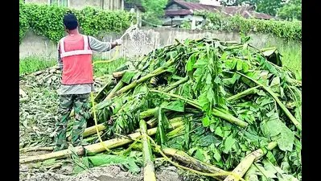
WASTE WITHIN AND OUTSIDE THE CAMPUS

Slide 9
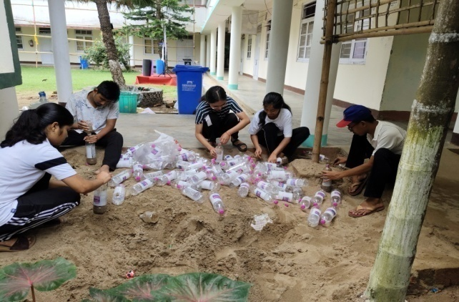
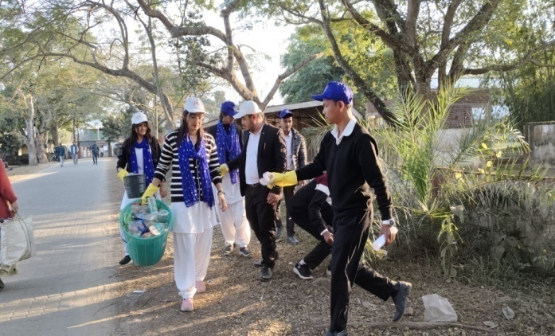
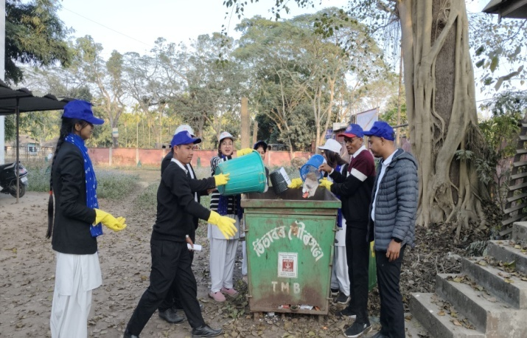
COLLECTION OF WASTE

Slide 10
TYPES OF WASTE
Bio-degradable waste: food scarps, garden waste , paper
Non-biodegradable waste: single use plastic , plastic bottles and tins
Construction debris
We planned to turn this waste into wealth

Slide 11
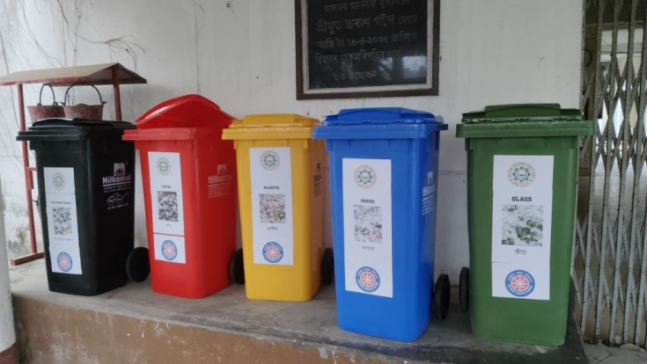
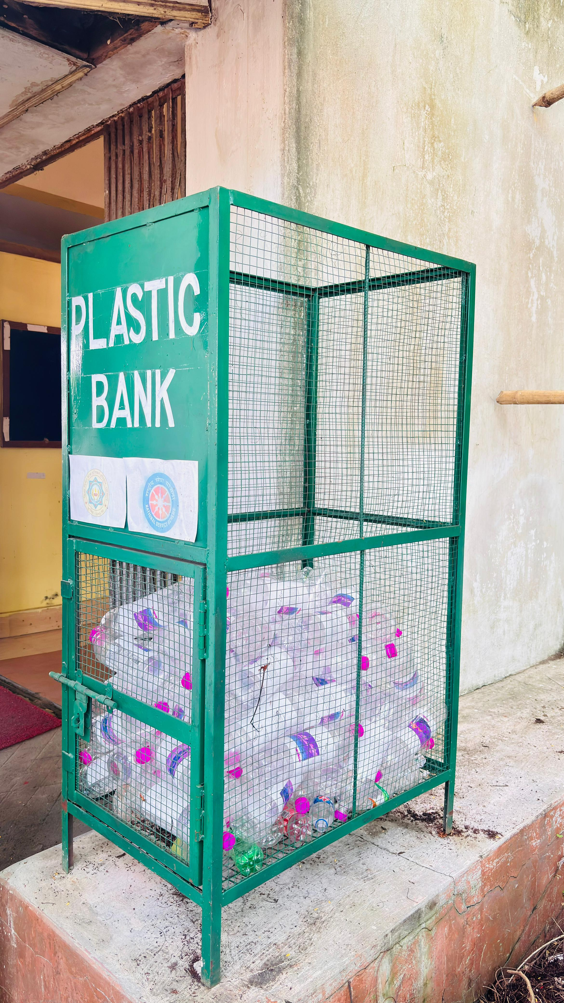
WASTE IS SEGREGATED INTO THREE CATEGORIES: ORGANIC, PLASTIC AND OTHER WASTES:
Using set of five color coded dustbins
Using Plastic collection bank

Slide 12
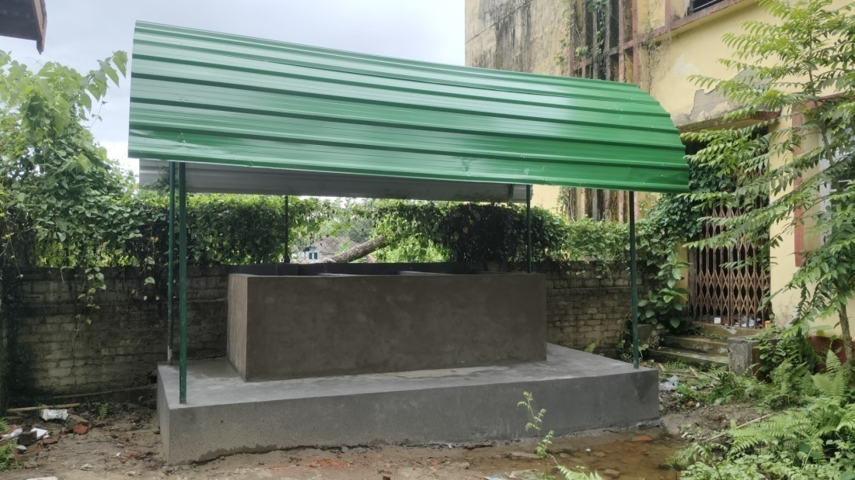
and VERMICOMPOSTING UNIT
Where organic waste is converted into compost which is used as manure for campus garden.

Slide 13
WASTE MANAGEMENT WITHIN THE CAMPUS

Slide 14
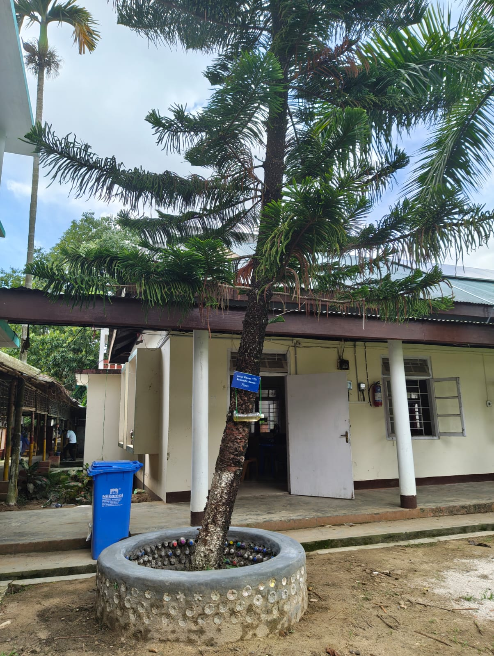
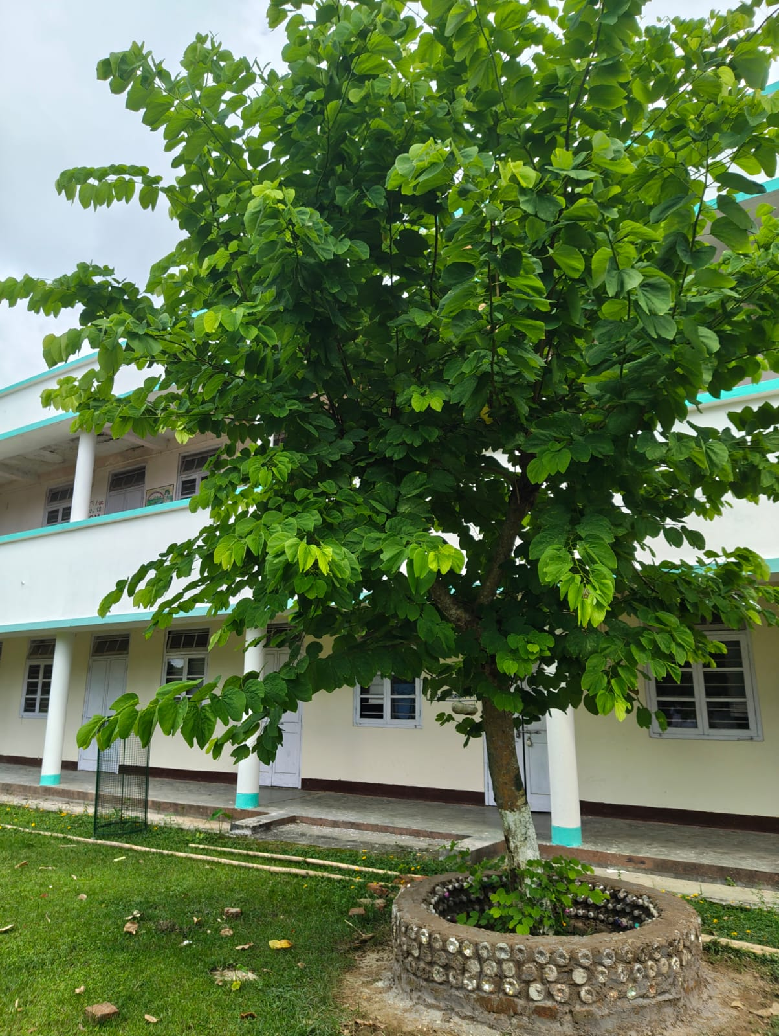
CONSTRUCTION OF SITTING CUM RESTING AREAS USING PLASTIC BOTTLES , SINGLE USE PLASTICS AND WRAPPERS. A TOTAL OF 500 PLASTIC BOTTLES WERE COLLECTED WITHIN THE CAMPUS POST PANCHAYAT ELECTION AND WAS USED FOR CONSTRUCTION .

Slide 15
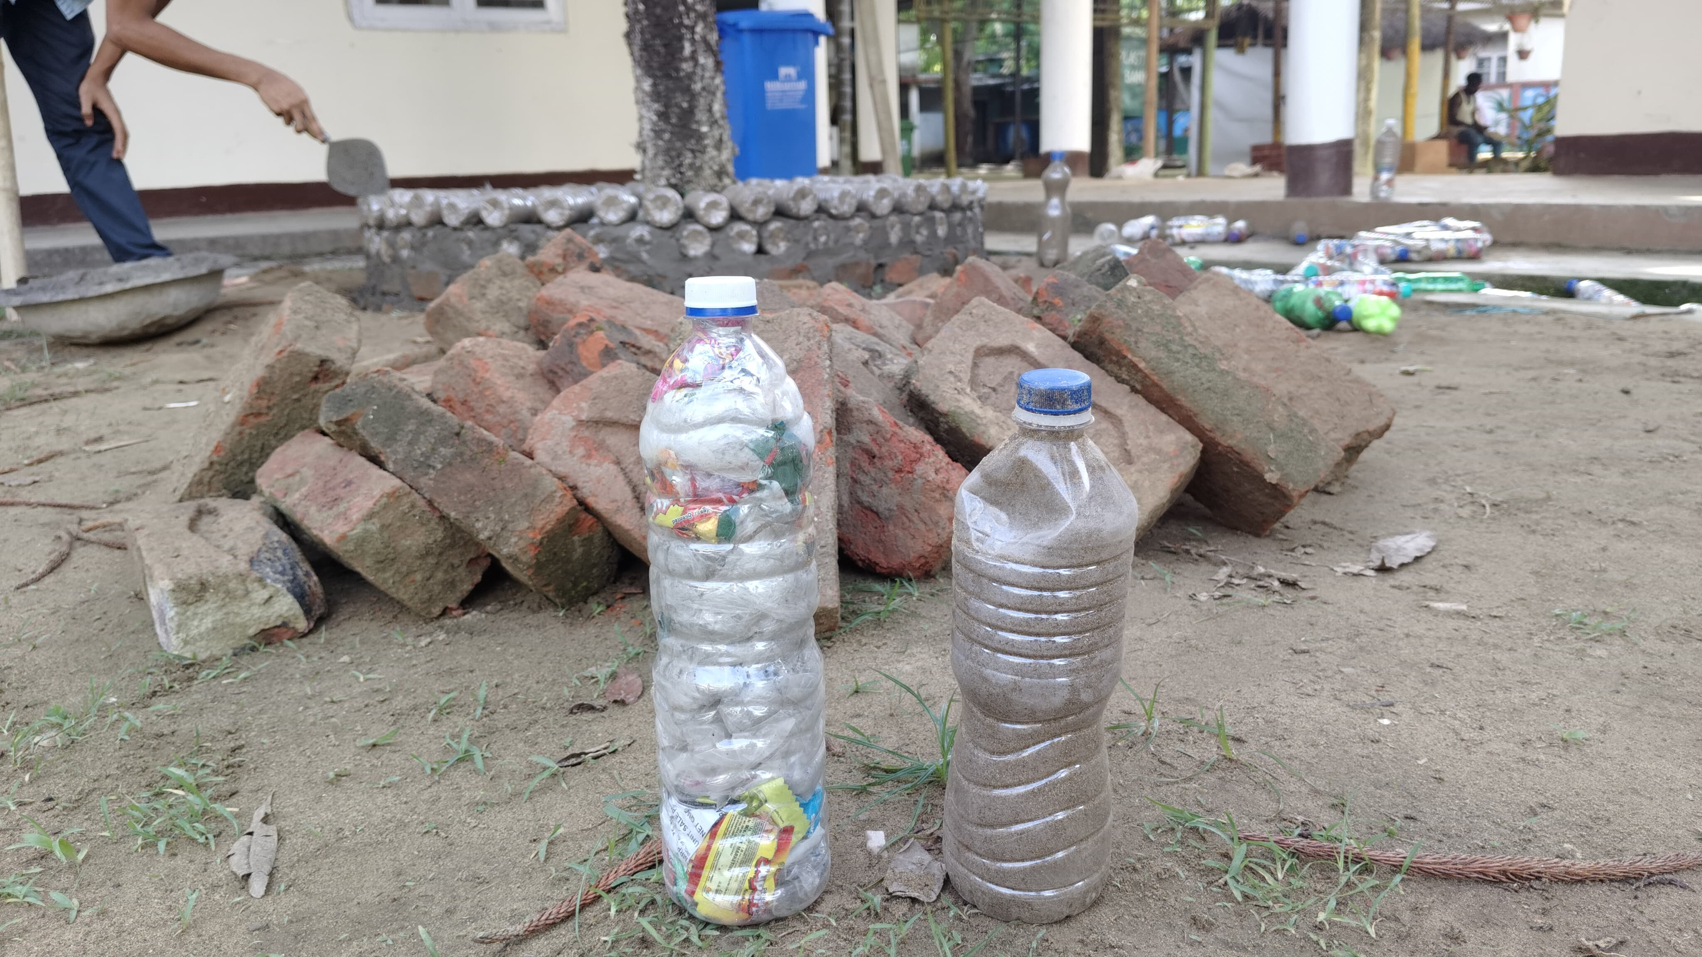
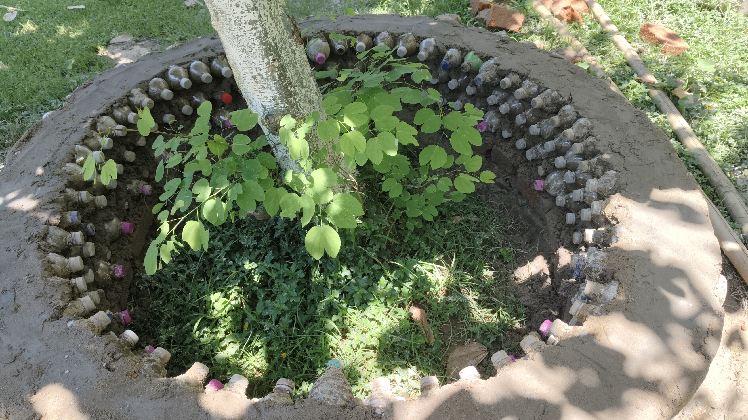
Using eco bricks for construction of sitting areas in the campus
eee
Eco Brick made of single use plastic and sand ;:

Slide 16
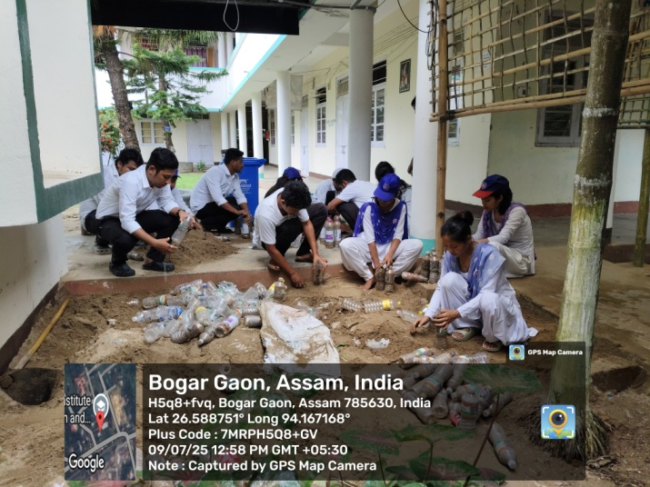
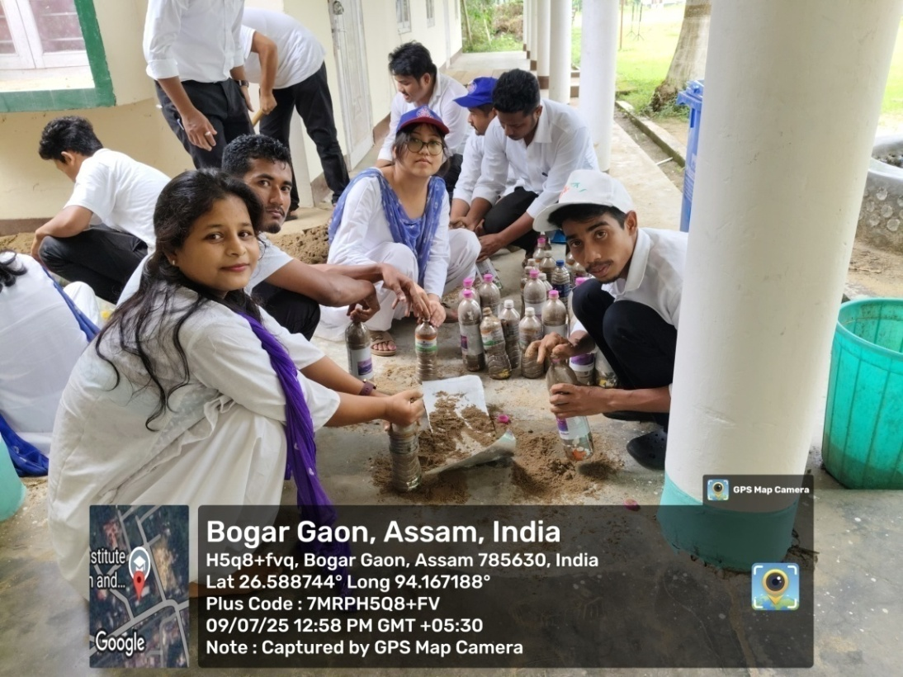
OUR TRANSFORMERS: TURNING WASTE INTO LEARNING OPPORTUNITIES.
Trainees filling plastic bottles with single use plastic papers and wrappers to make eco bricks
Making Eco bricks by our trainees.

Slide 17

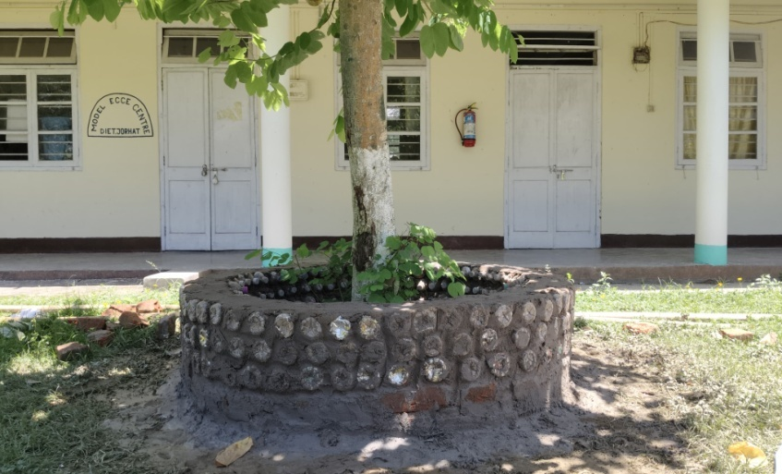
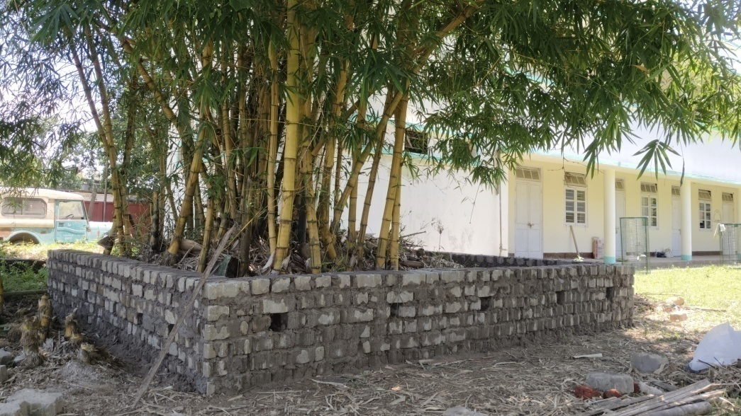
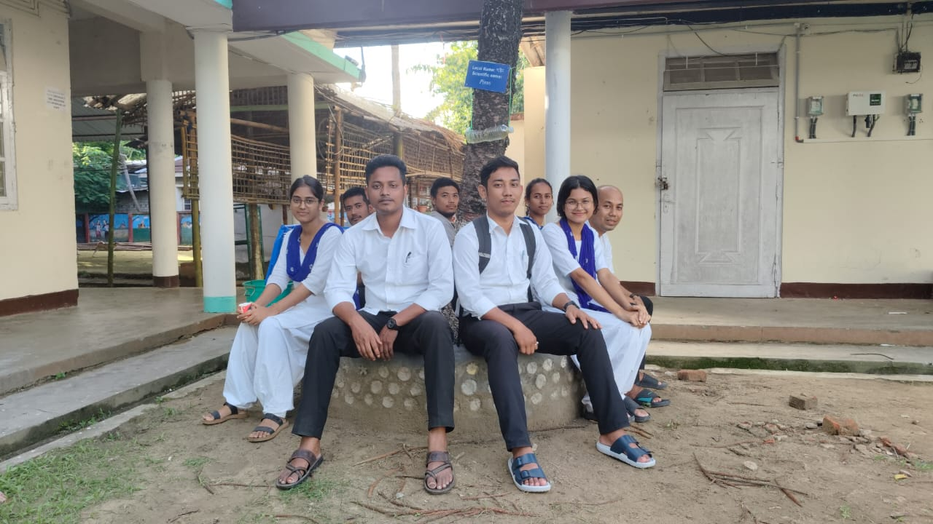
SUSTAINABLE AND ECO FRIENDLY LIVING:
WAITING CUM SITTING AREA

Slide 18
WASTE MANAGEMENT OUTSIDE CAMPUS

Slide 19
WASTE MANAGEMENT THROUGH UNITY: COMMUNITY INVOLVEMENT
During Diwali and other festivals, banana plants are used as stands for earthen lamps and are discarded leading to waste on streets and garbage bins.
After the fruit is harvested the stem is left behind.
We planned to turn this waste into wealth with community involvement

Slide 20
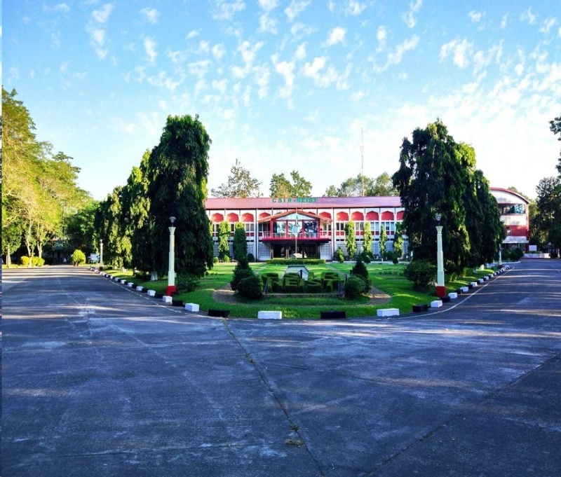
AND WITH SUPPORT FROM CSIR-NORTH EAST INSTITUTE OF SCIENCE AND TECHNOLOGY ASSAM ,WE STARTED OUR PROJECT
‘TRANSFORMING WASTE TO WEALTH’
Dr Dipul Kalita ,Senior Principal scientist supported us.
Under his guidance we procured a Banana Fiber extracting machine .
Our students, community members were trained by resource persons from CSIR-NEIST under the leadership of Dr.Dipul Kalita

Slide 21
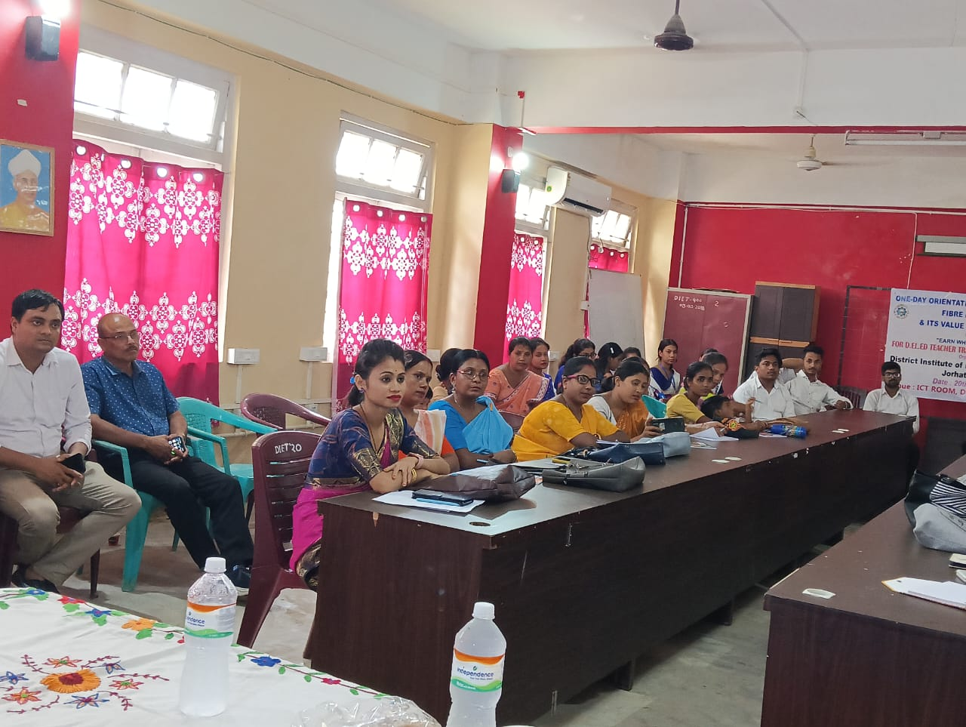
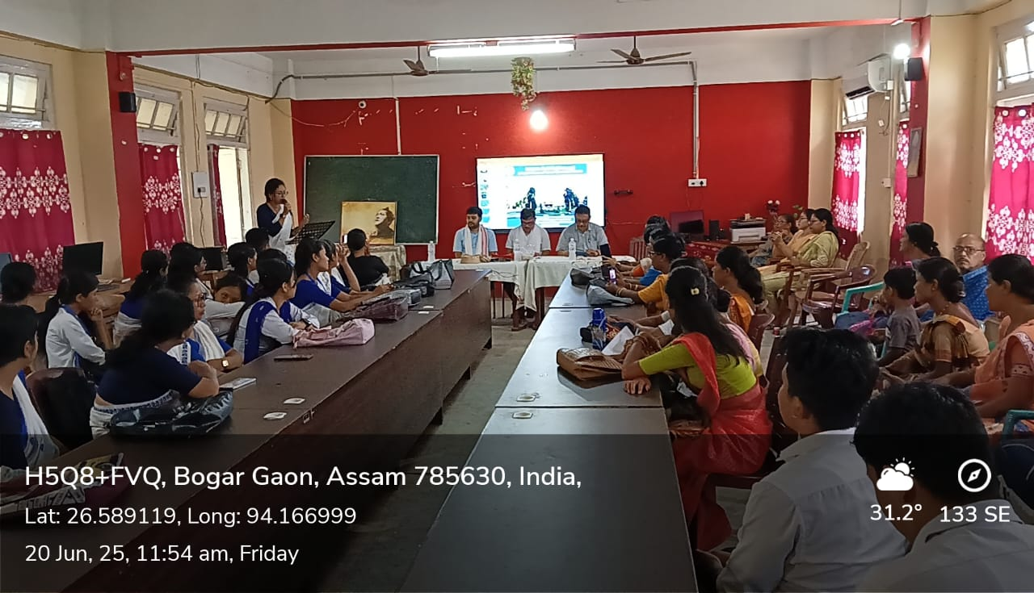
TRAINING ON BANANA FIBER BY CSIR-NEIST ASSAM INDIA.
STUDENTS ,FACULTY AND COMMUNITY MEMBERS PARTICIPATED.

Slide 22
METHOD OF BANANA FIBER EXTRACTION
Banana Fiber is extracted from the sheath by three methods:
Mechanical process –separated the fiber mechanically with the help of a responder
Chemical process- extracted the fiber by chemical process adopting pressure free digestion in open condition
Manual process- extracted from the sheath with the help of a scrapper

Slide 23
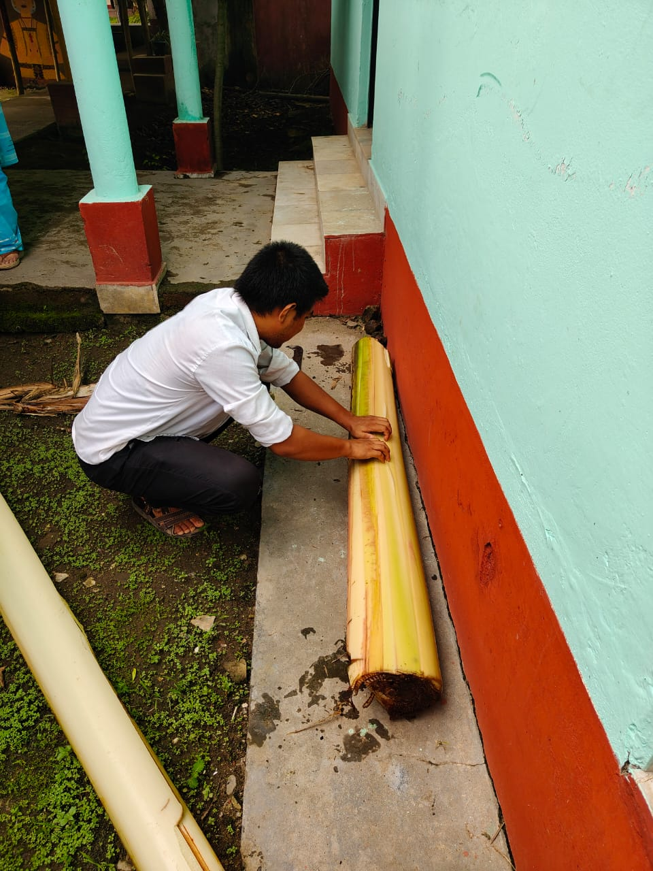
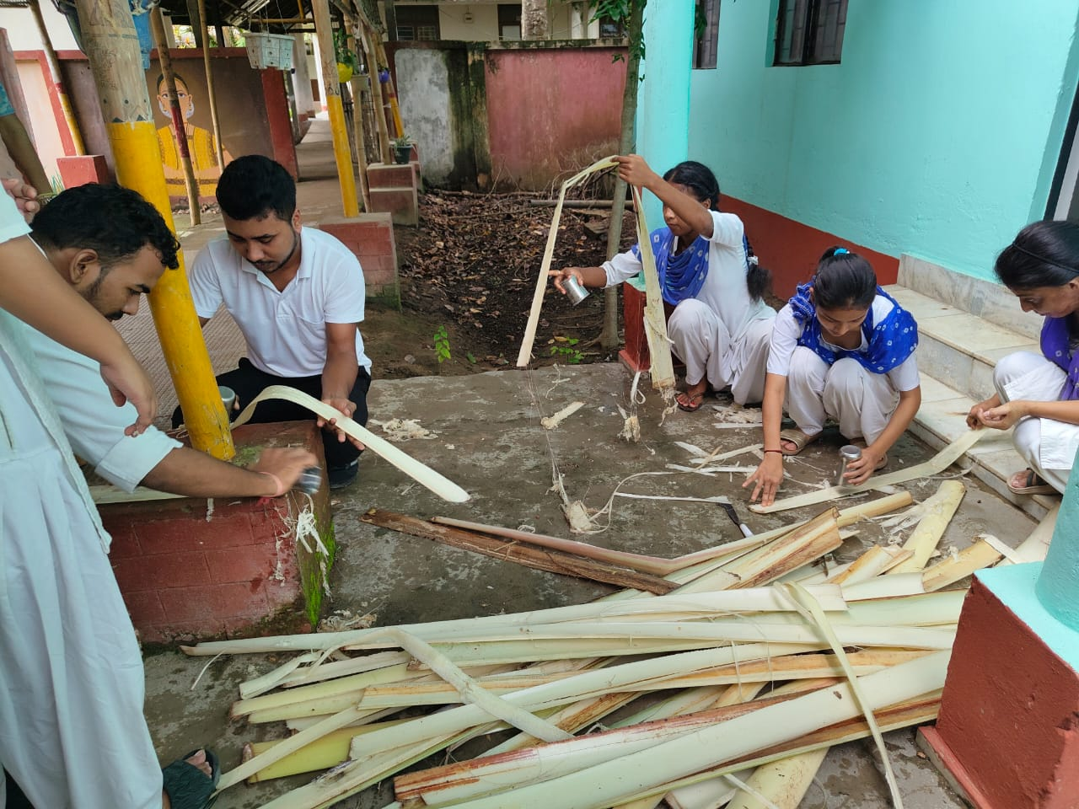
MANUFACTURING PROCESS OF BANANA FIBER
Cutting stems of banana plant and converting into strips

Slide 24
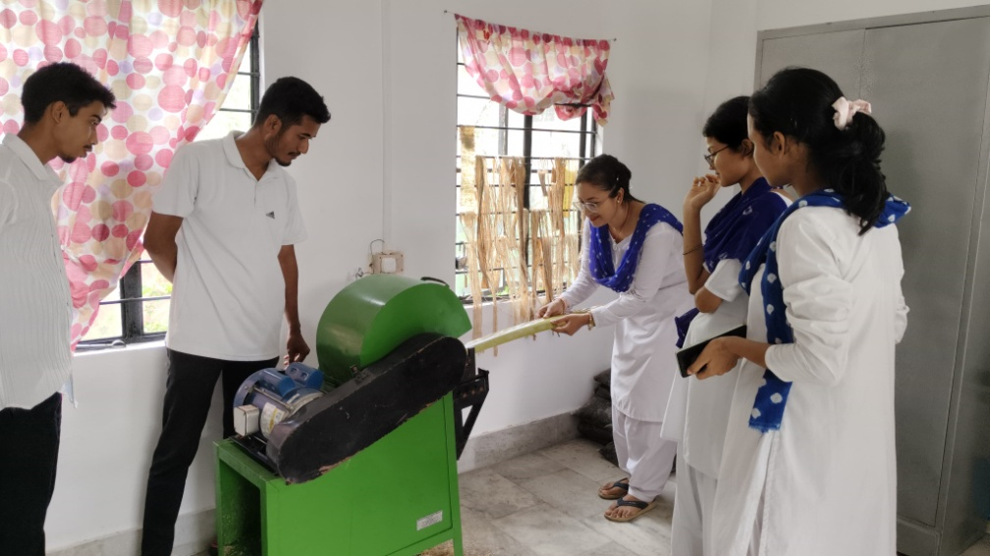
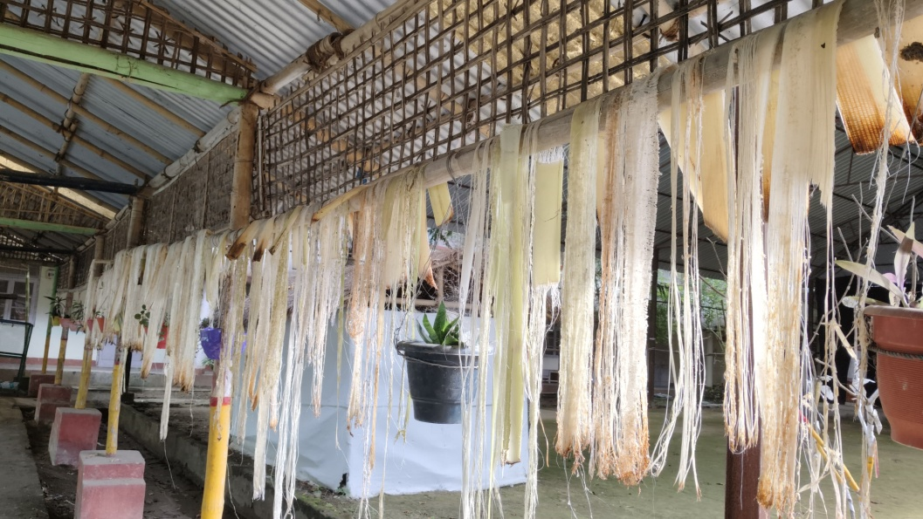
Extracting fiber in a responder
Drying the fibers

Slide 25
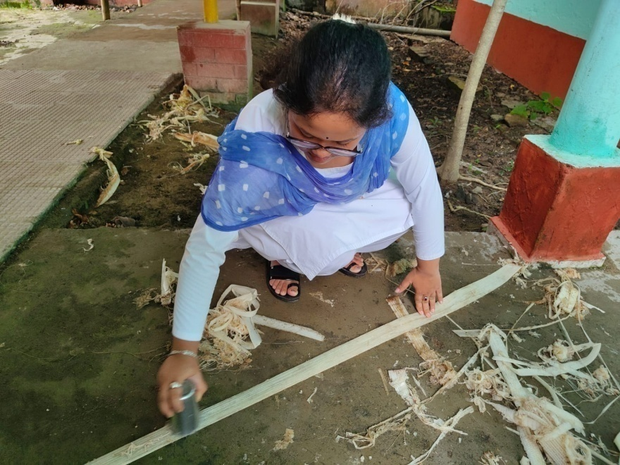
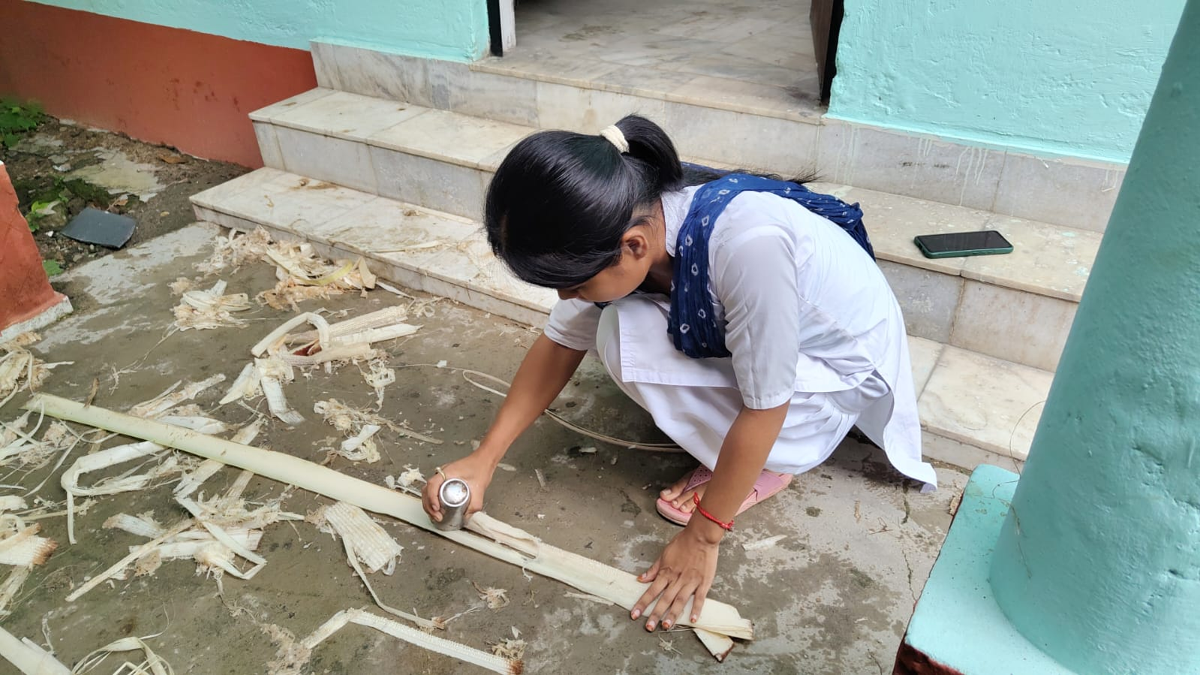
EXTRACTING FIBER MANUALLY BY USING STEEL GLASS

Slide 26
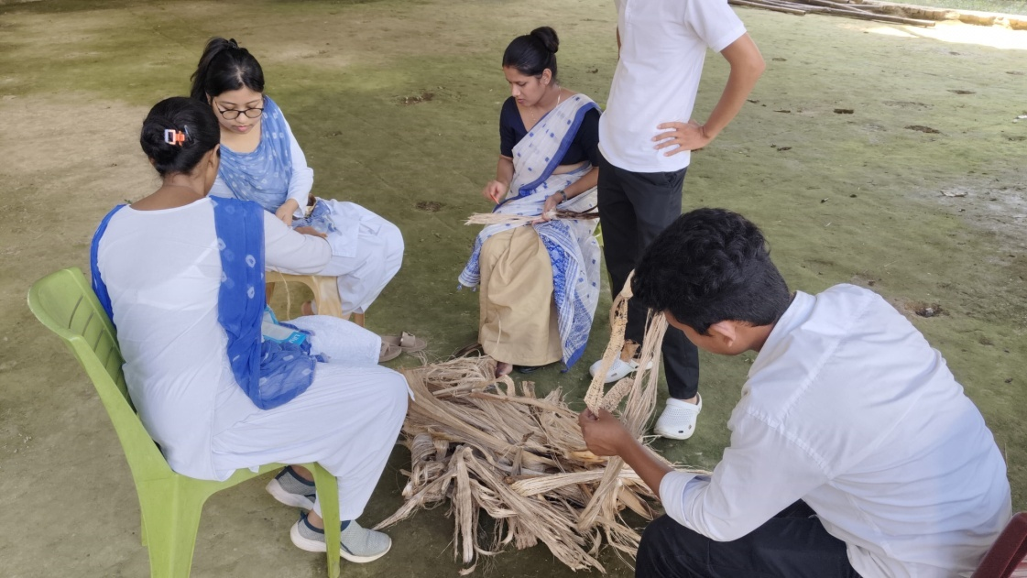
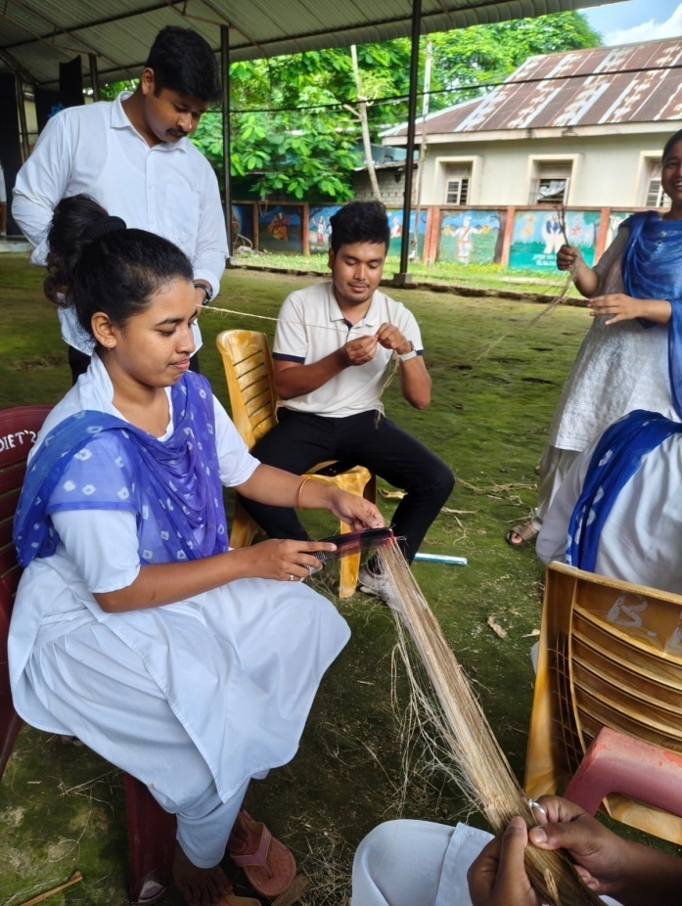
CLEANING AND COMBING

Slide 27
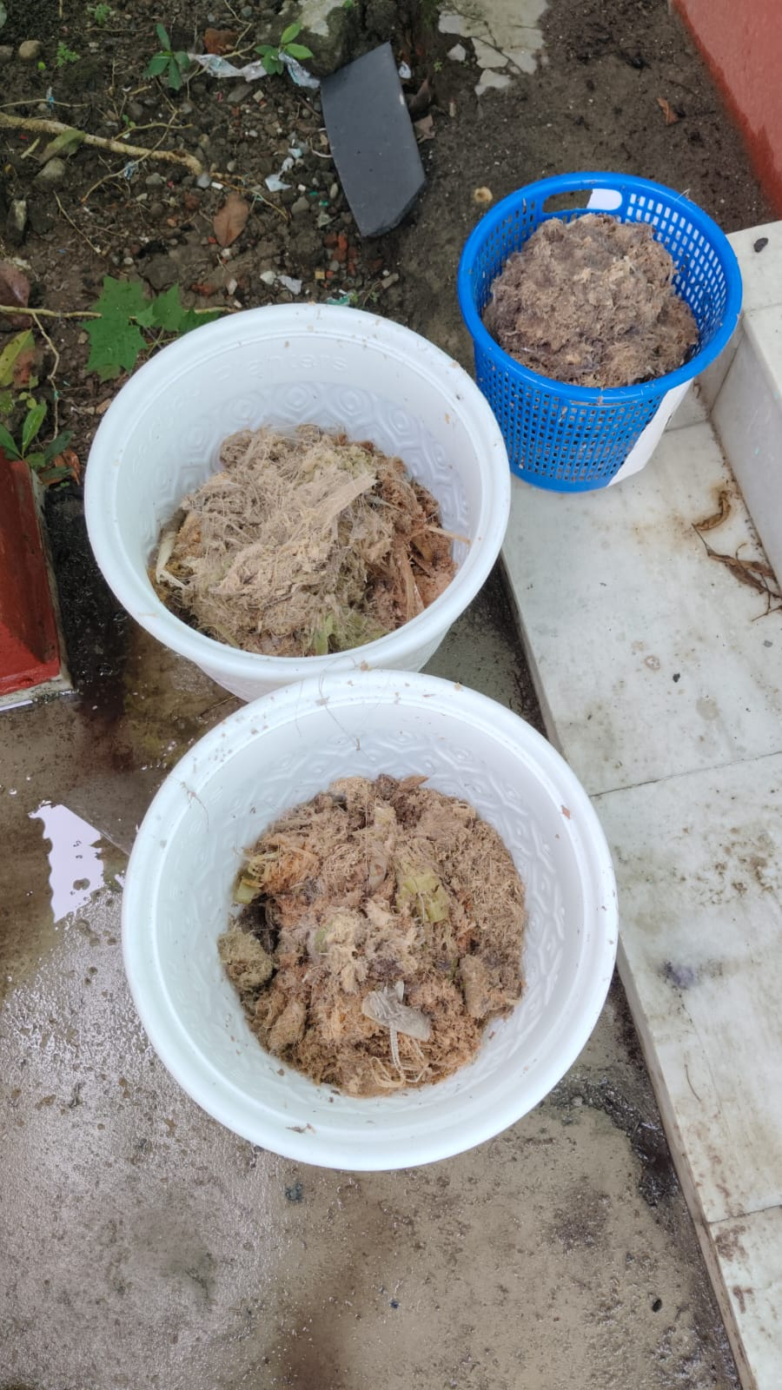
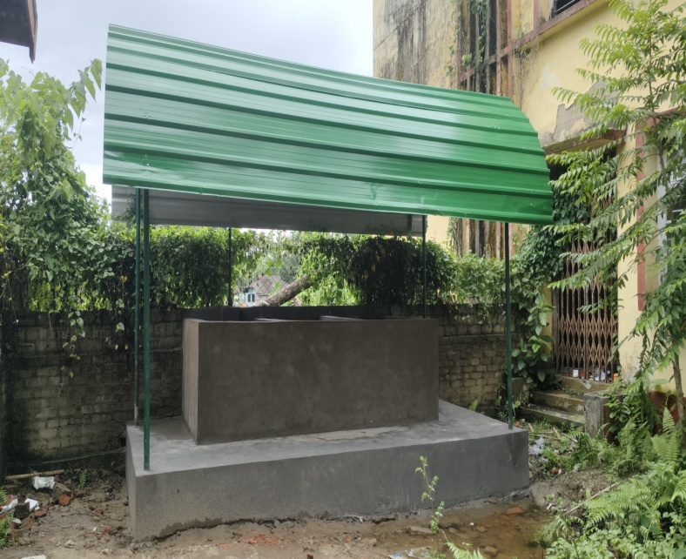
The husk/pulp is converted into compost in the composting unit

Slide 28
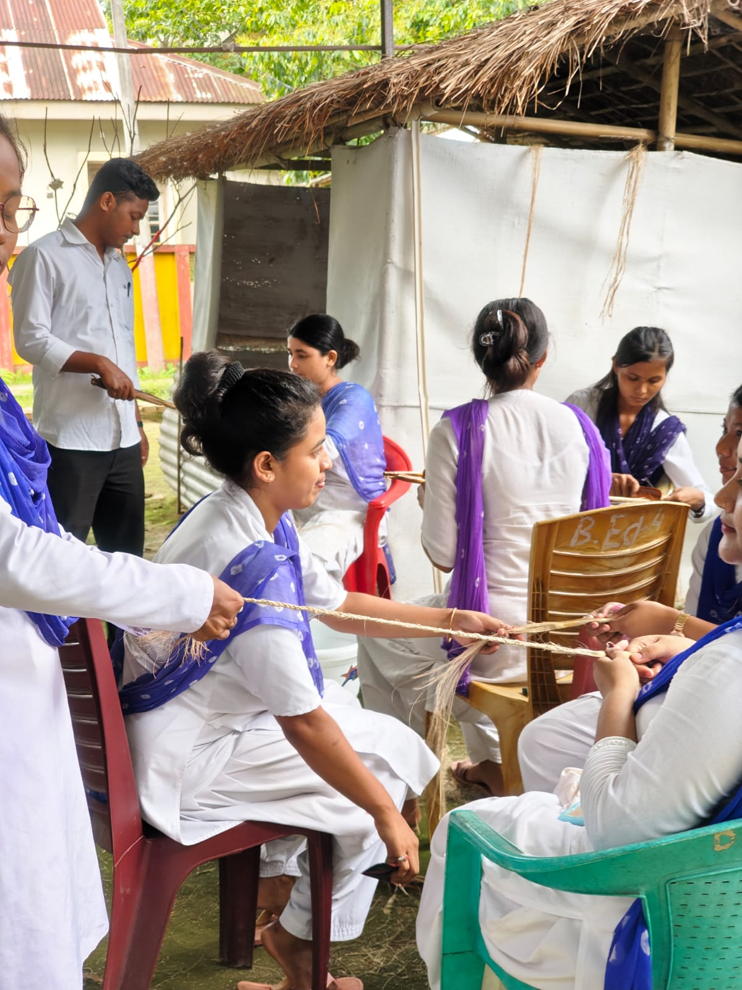
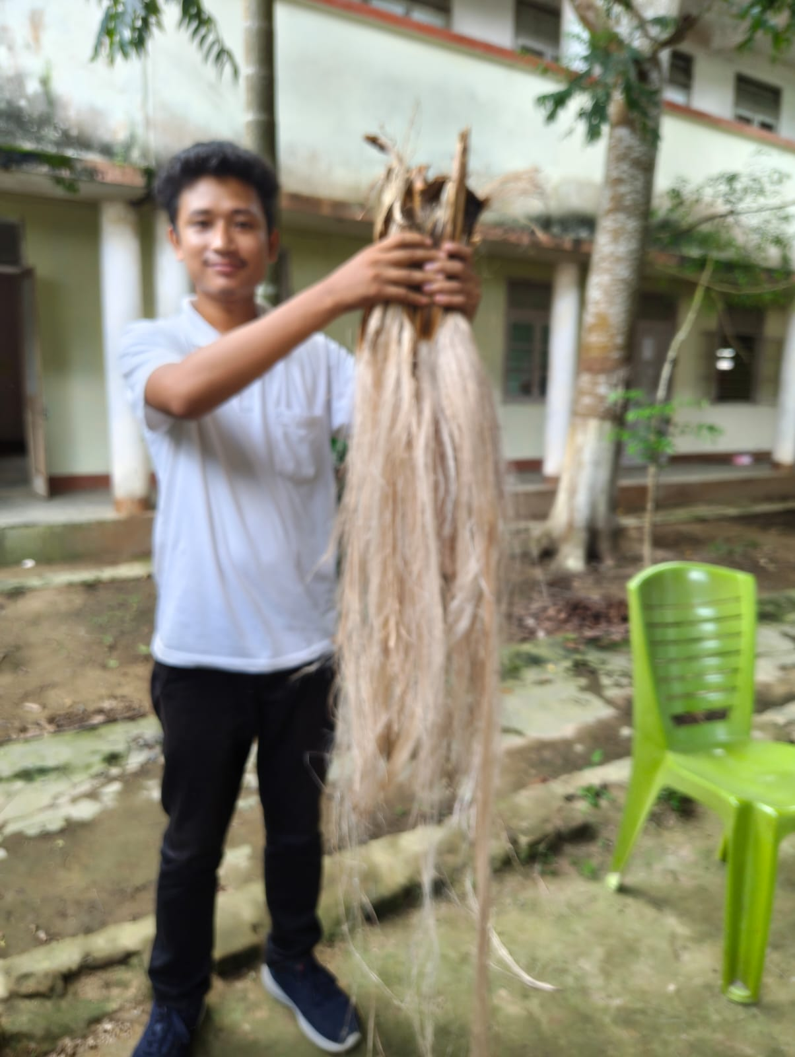
FIBER READY FOR USE TO MAKE ECO FRIENDLY ITEMS

Slide 29
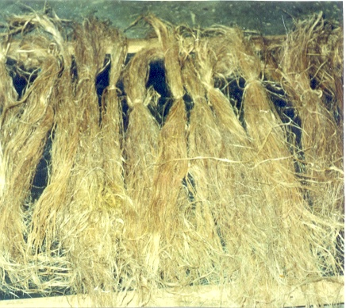
FIBER BUNDLES

Slide 30
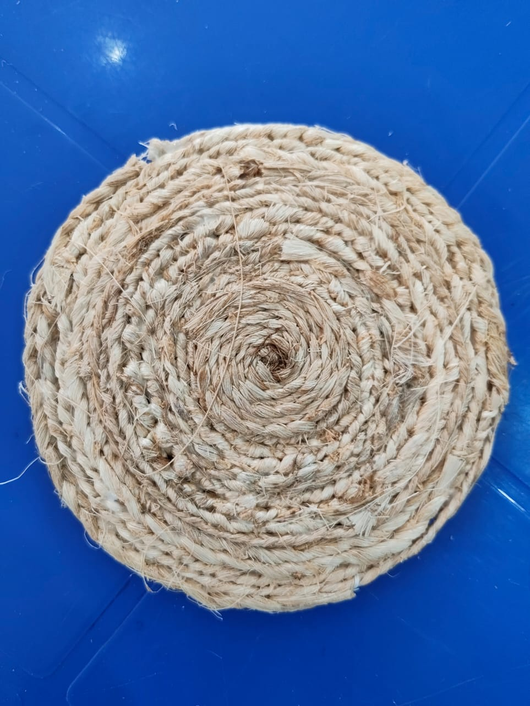
THE FINAL PRODUCT
TEA COASTER

Slide 31
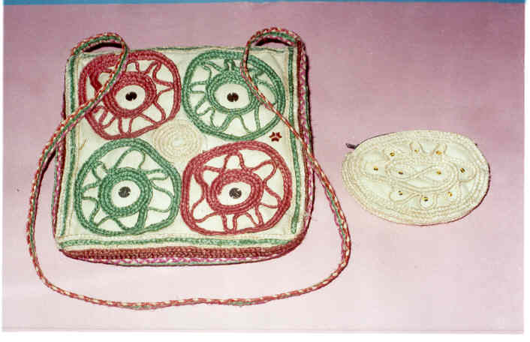
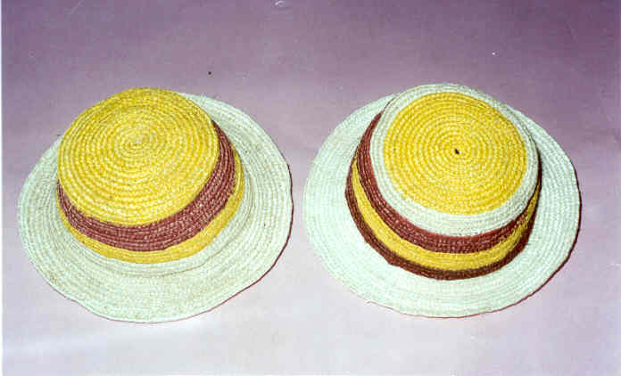
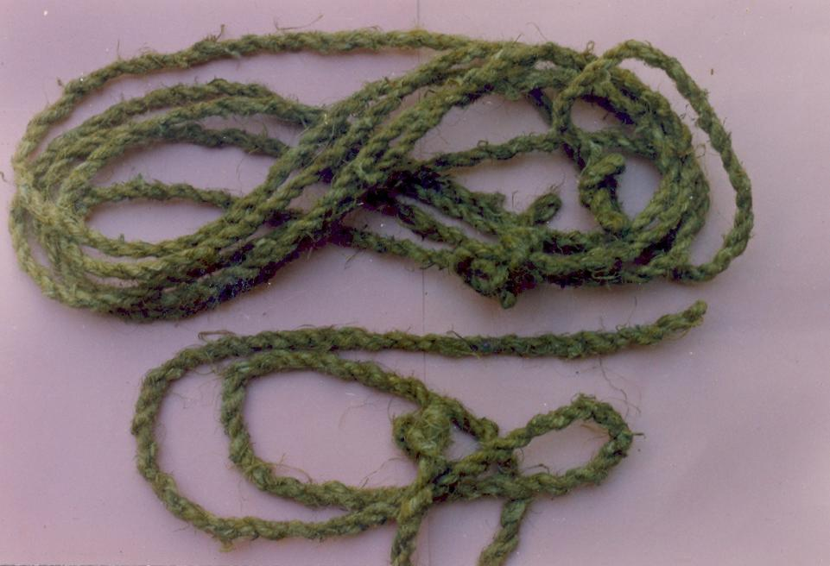
PRODUCTS TO BE MADE IN WORKSHOP AFTER END SEMESTER EXAMINATION

Slide 32
WHY WE INVOLVED COMMUNITY
IN OUR PROGRAMME WE INVOLVED THE COMMUNITIES OF OUR TWO ADOPTED VILLAGE.
OUR OBJECTIVE WAS TO ENHANCE COMMUNITY INSTITUTION RELATIONSHIP USING BANANA FIBER-AN EXAMPLE OF WASTE TO WEALTH AND SUSTAINABLE COLLABORATION.

Slide 33
OUR PROJECT
Transforming Waste to Wealth: Community Based Banana Fiber Production from Waste at DIET Jorhat

Slide 34
Project Benefits to Community
Income generation, environmental awareness and responsibility
Skill development: community learns new skill- fiber extraction, weaving or crafting.
Stronger community Institution bond:
build trust and cooperation between institute and local community
encourage joint responsibility in waste management and innovation

Slide 35
PROJECT BENEFITS TO THE INSTITUTION
Offers real world example of sustainable resource management
Student teachers learn about environmental education, circular economy and community engagement
Can be integrated into EVS and Work education Curriculam

Slide 36
HOW THE PROJECT WORKS!
Green campus initiative
Promotes the institute as a model for sustainability and innovation
Reduces waste generated during festivals
Hands on project work
Trainees participate in the banana fiber process: documentation , awareness drives , exhibitions
Offers opportunities for action research , case studies or school project.

Slide 37
Recognition and collaboration
Opens doors for partnership with eco conscious NGO’s , local bodies
May receive recognition for innovative environmental education
Use of final products
Banana fiber can be used to make eco friendly folders , craft items ,mats , ropes and teacher training resources.
Products can be sold , gifted during events or used in the institution.

Slide 38
OUR ROADMAP
ACTIVITY | DESCRIPTION | STAKEHOLDER
Banana fiber workshop | Hands on training in fiber extraction | Trainees and community
Community collection drive | Organize stem collection post festival and harvest | Community and trainees
Craft making workshop | Using fiber to create usable items | Trainees and community
Sustainable exhibition | Displaying eco products and promoting reuse | Local schools and public
Curriculum integration | EVS lessons on Resource recovery | Trainees and faculty

Slide 39
CONCLUSION
This initiative embeds sustainability into teacher education, empowers local community and gives life to cultural and agricultural waste . It not only solves a local waste problem but transforms it into economic opportunity, educational content and environmental action

Slide 40
FOR DETAILS PLEASE CONTACT :
Director,
CSIR-North East Institute of Science & Technology
JORHAT 785 006, Assam, India.
E.MAIL : director@neist.res.in
Web Site : www.neist.res.in

Slide 41
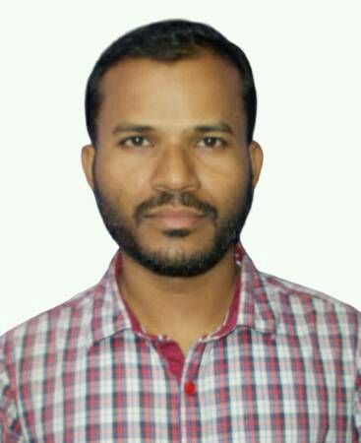
We acknowledge the contribution of Puna Das, Lecturer, Work Education transferred to DIET, Dhemaji last month.

Slide 42
Thank You…
Please log into www.dietjorhat.in
Email address: dietjorhat@rediffmail.com

